Slide 1
Progress Report 1 – 10/17/2017
Soumya MISHRA

Slide 2
Problem
25% - 50% of what computers do require sorting algorithms for
Efficiency (speed)
Processing Data
Sorting algorithms
Best case – time it takes to sort an already sorted data set
Worst case – time its takes to sort an unsorted data set

Slide 3
Problem
Bucket sort (non-comparison sort, widely used and respected)
Sorts data into respective buckets
Uses merge sort to sort the buckets
Best case of O(n+k)
Worst Case of O(n^2)
Problems with Bucket sort
Too much of the data lies within a specific range – slows down algorithm
Takes up too much space for some buckets will not be used

Slide 4
Goal in Depth
Calculates parameters of n number of buckets based on elements in data set
<1000 elements in each bucket (number of elements are equal)
Should be able to sort data sets that follow any type of distribution

Slide 5
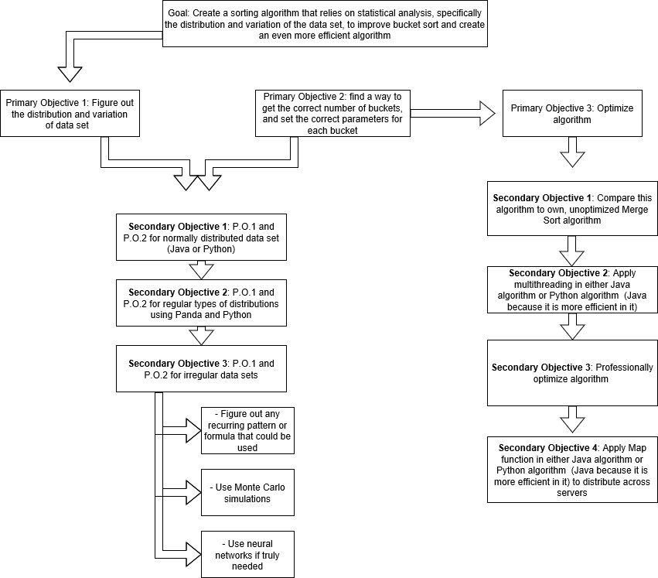

Slide 6
What Has Been Done Thus Far
Created backbone of algorithm in Java
Technical errors in preliminary code took time to figure out
Collected data when compared to Parallel Sort/Merge Sort
Transferring code into Python and learning Panda

Slide 7
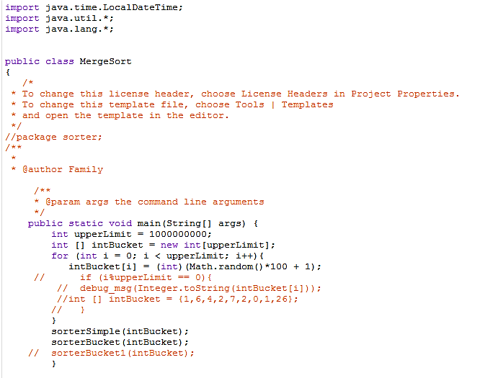
Backbone Code in Java – Main
Main method that creates the randomized array
Outputs parallel sort and new sort run times

Slide 8
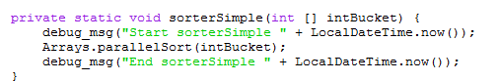
Backbone in Java – Parallel Sort
Getting run time of Parallel Sort – this is a Java merge-sort like sorting algorithm used to sort arrays by threading

Slide 9
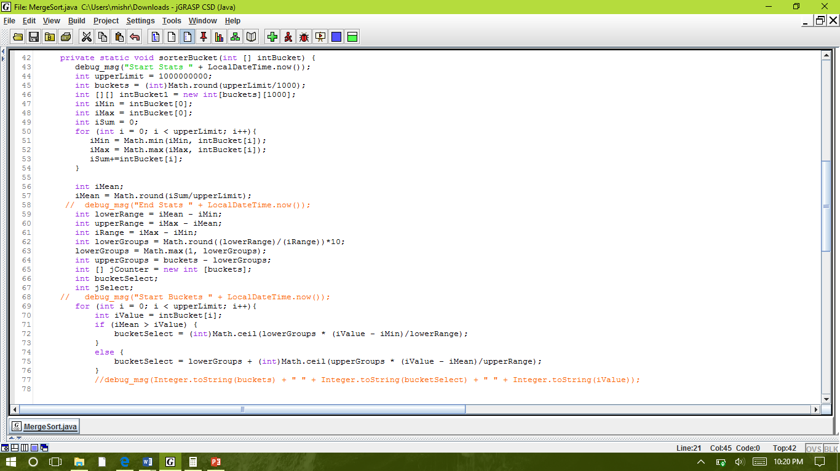
Backbone in Java – Stat Sort
This is the method that performs the new sort
This part of the method is calculating the
Max and min
mean
The lower range
The upper range
The number of buckets for the two ranges

Slide 10
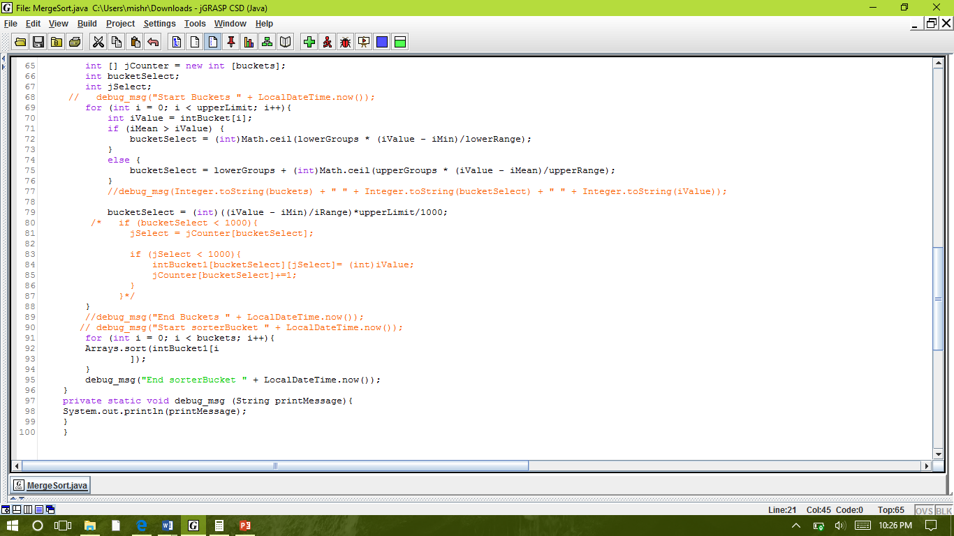
Backbone in Java – Buckets
This is the part of the method in which the elements are being sorted into their respective buckets
Inputs the end time of the sort which is used to calculated run time

Slide 11
Data Collected
 | Parallel Sort (Optimized) |  |  |  | New Sort |  |  |  | Percent Faster (%)*
Elements | Trial 1 (s) | Trial 2 (s) | Trial 3 (s) | Average (s) | Trial 1 (s) | Trial 2 (s) | Trial 3 (s) | Average (s)
1000 | 0.31 | 0.20 | 0.27 | 0.26 | 0.01 | 0.02 | 0.02 | 0.01 | 95.40
10000 | 0.31 | 0.36 | 0.37 | 0.35 | 0.02 | 0.01 | 0.02 | 0.01 | 96.04
100000 | 0.24 | 0.25 | 0.28 | 0.26 | 0.05 | 0.08 | 0.07 | 0.07 | 74.03
1000000 | 0.62 | 0.68 | 0.51 | 0.61 | 0.16 | 0.16 | 0.13 | 0.15 | 74.82
10000000 | 0.48 | 1.25 | 1.24 | 0.99 | 0.26 | 0.54 | 0.47 | 0.42 | 57.32
100000000 | 5.71 | 5.91 | 5.82 | 5.81 | 3.31 | 3.06 | 3.40 | 3.26 | 44.01
10000000000 | HEAP ERROR
*Efficiency keeps decreasing – due to high standard error
Heap errors will be solved by using a 6-node server (later in the process)

Slide 12
Data Collected

Slide 13
Goals Until The Next Progress Report
Transfer algorithm into Python – next two weeks
Learn how to implement Panda and how Panda works– next four weeks
Use Panda in algorithm and check whether it will sort the data sets – whole of November, a bit into December
Implement Panda-like method into Java algorithm – November and December

